Slide 1
SQL Structured Data Language
Date: 03.11.2014 Daniel Popa

Slide 2
Topics
Introduction
DDL vs. DML
Data QUERY (SELECT Clause)
Constraints
Data Filtering & Ordering (WHERE, ORDER BY)
Retrieving data from multiple tables
Views
Single row & group functions
Generating DB structure using Liquibase

Slide 3
Introduction
1

Slide 4
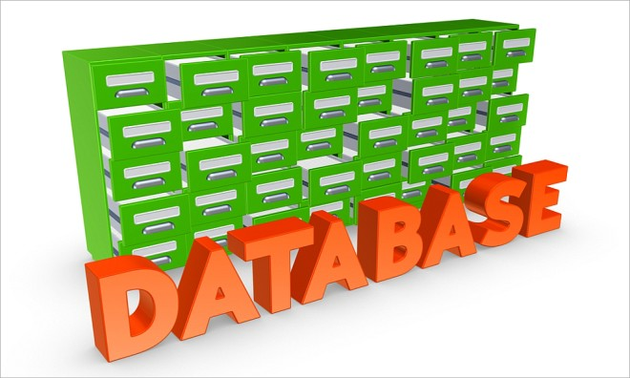
Introduction
What is a database?
A database is a collection of data that is
organized so that its contents can easily be
accessed, managed, and updated.

Slide 5
Introduction
What is a relational model?
RDBMS – Relational DataBase Management System
A collection of objects and relations that stores data. In our case this is represented by tables, organized in rows and columns.
A set of operations that acts on the relations to create other relations
Assures data integrity for accuracy and consistency

Slide 6
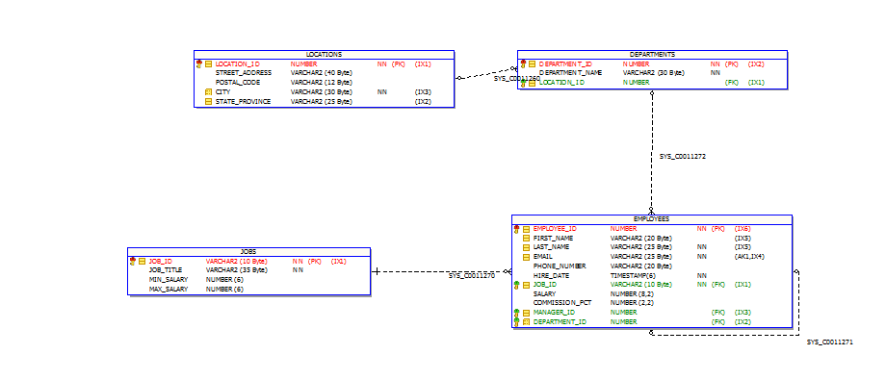
Introduction
What is a relational model?
RDBMS – Relational DataBase Management System
A collection of objects and relations that stores data. In our case this is represented by tables, organized in rows and columns.
A set of operations that acts on the relations to create other relations
Assures data integrity for accuracy and consistency

Slide 7
DDL vs. DML
2

Slide 8
DDL – Data Definition Language
What is a Data Definition Language?
A data definition language or data description language (DDL) is a syntax similar to a computer programming language for defining data structures, especially database schemas.
The Data Definition Language (DDL) is used to create and destroy databases and database objects.

Slide 9
DDL – Data Definition Language
The CREATE TABLE statement is used to create a table in a database.
Tables are organized into rows and columns; and each table must have a name.
SQL CREATE TABLE Syntax
CREATE TABLE table_name
(
column_name1 data_type(size),
column_name2 data_type(size),
column_name3 data_type(size),
);
column_name - names of the columns of the table.
data_type - type of data the column can hold (e.g. varchar, integer, decimal, date, etc.).
size parameter - maximum length of the column of the table.

Slide 10
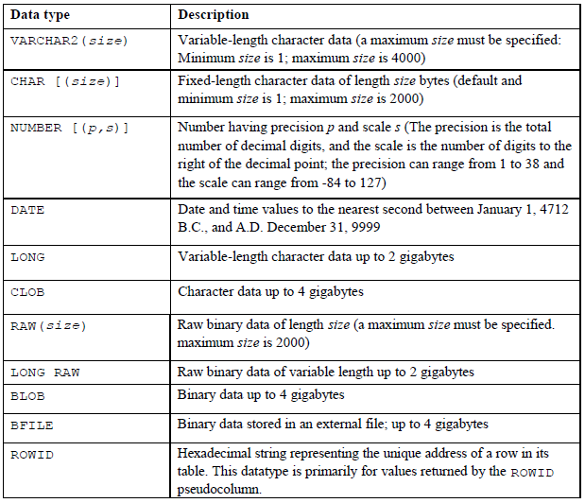
DDL – Data Definition Language

Slide 11
DDL – Data Definition Language
The ALTER TABLE statement is used to add, delete, or modify columns in an existing table.
SQL ALTER TABLE Syntax
--adda column in a table
ALTER TABLE table_name
ADD column_name datatype
--delete column from table
ALTER TABLE table_name
DROP COLUMN column_name

Slide 12
DML – Data Manipulation Language
Data Manipulation Language (DML)
A DML statement is executed when:
A new record is added (INSERT)
An existing record is modified(UPDATE)
A record is deleted (DELETE)

Slide 13
DML – Data Manipulation Language
The INSERT statement is used to insert new records in a table.
SQL INSERT INTO Syntax
Two ways of doing INSERT INTO:
INSERT INTO table_name
VALUES (value1,value2,value3,...);
INSERT INTO table_name (column1,column2,column3,...)
VALUES (value1,value2,value3,...);

Slide 14
DML – Data Manipulation Language
The UPDATE statement is used to update existing records in a table.
SQL UPDATE Syntax
UPDATE table_name SET column1=value1,column2=value2,... WHERE some_column=some_value;
The DELETE statement is used to delete rows in a table.
SQL DELETE Syntax
DELETE FROM table_name WHERE some_column=some_value;

Slide 15
Data QUERY (SELECT Clause)
3

Slide 16
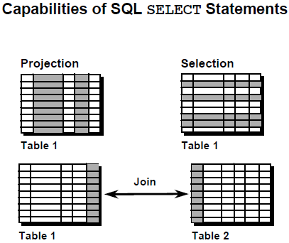
SELECT Clause
Projection: Capability of choosing the
columns from a table that will be
retrieved by the syntax SELECT SQL.
Selection: Capability of choosing the
rows that will be retrieved from a query.
Join: Capability of combining data
from many tables by creating
connections between the tables (JOIN).

Slide 17
SELECT Clause
The SELECT statement is used to select data from a database.
The result is stored in a result table, called the result-set.
SQL SELECT Syntax
--retrieves specific columns from the table
SELECT column_name1, column_name2
FROM table_name;
And
SELECT * FROM table_name;

Slide 18
Constraints
4

Slide 19
Constraints
SQL constraints are used to specify rules for the data in a table.
If there is any violation between the constraint and the data action, the action is aborted by the constraint.
Constraints can be specified when the table is created (inside the CREATE TABLE statement) or after the table is created (inside the ALTER TABLE statement).

Slide 20
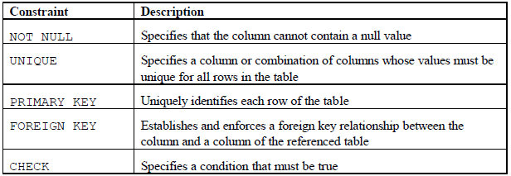
Constraints

Slide 21
Data Filtering & Ordering (WHERE, ORDER BY)
5

Slide 22
WHERE Clause
The WHERE clause is used to extract only those records that fulfill a specified criterion.
SQL WHERE Syntax
SELECT column_name1, column_name2 FROM table_name WHERE column_name1 operator value;

Slide 23
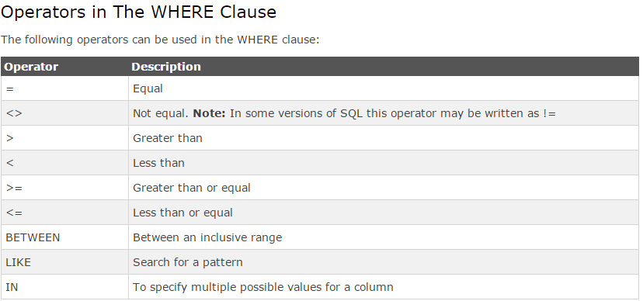
WHERE Clause

Slide 24
Order By Clause
The ORDER BY keyword is used to sort the result-set by one or more columns.
The ORDER BY keyword sorts the records in ascending order by default.
To sort the records in a descending order, you can use the DESC keyword.
SQL ORDER BY Syntax
SELECT column_name1,column_name2 FROM table_name ORDER BY column_name1,column_name2 ASC|DESC;

Slide 25
Retrieving data from multiple tables
6

Slide 26
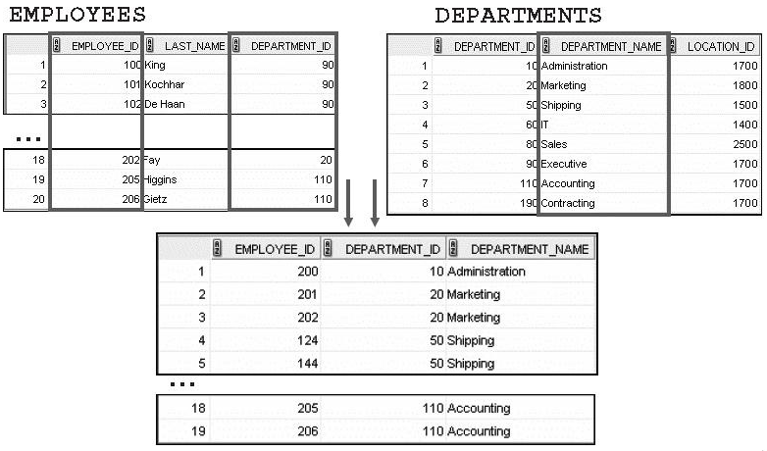
Data from multiple tables

Slide 27
SQL Joins
An SQL JOIN clause is used to combine rows from two or more tables, based on a common field between them.
The SQL INNER JOIN keyword returns all rows from multiple tables where the join condition is met.
The LEFT JOIN keyword returns all rows from the left table (table1), with the matching rows in the right table (table2). The result is NULL in the right side when there is no match.
The RIGHT JOIN keyword returns all rows from the right table (table2), with the matching rows in the left table (table1). The result is NULL in the left side when there is no match.
The FULL OUTER JOIN keyword returns all rows from the left table (table1) and from the right table (table2).

Slide 28

SQL Joins

Slide 29
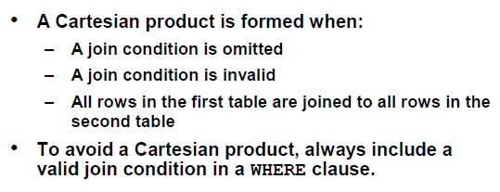
SQL Joins

Slide 30
Views
7

Slide 31
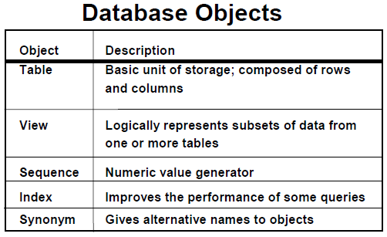
Views

Slide 32
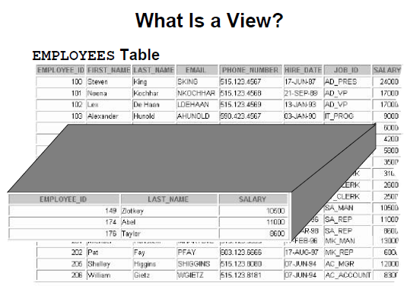
Views

Slide 33
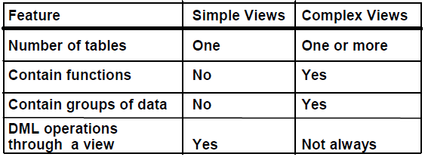
Views
In SQL, a view is a virtual table
based on the result-set of an SQL
statement.
A view contains rows and columns, just like a real table. The fields in a view are fields from one or more real tables in the database.
You can add SQL functions, WHERE and JOIN statements to a view and present the data as if the data were coming from one single table.

Slide 34
Views
SQL CREATE VIEW Syntax
CREATE VIEW view_name AS
SELECT column_name(s)
FROM table_name
WHERE condition
A view always shows up-to-date data! The database engine recreates the data, using the view's SQL statement, every time a user queries a view.

Slide 35
Single row & group functions
8

Slide 36
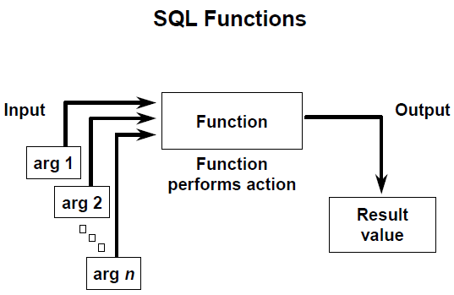
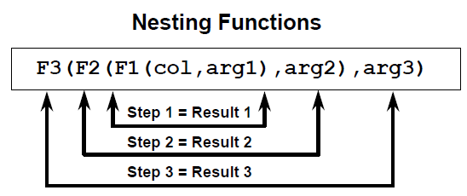
Single row functions
What are single row functions?
Are manipulating data
Accept arguments and return a single value
Act on each row
Retrieve a single result per each record
Pot modifica tipul de data
Can be nested
Arguments can be table columns or expressions

Slide 37
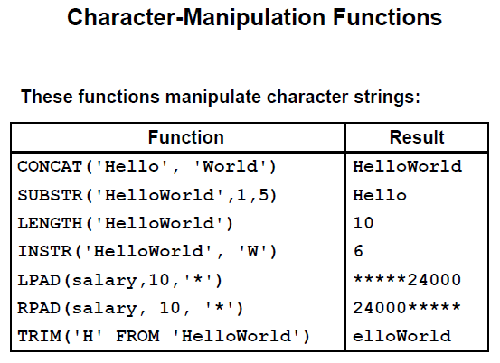
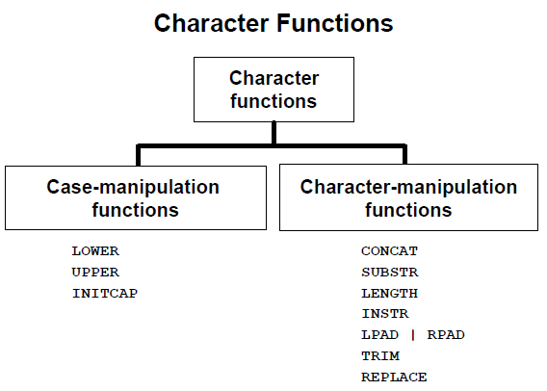
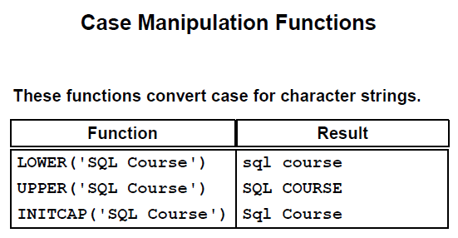
Single row functions

Slide 38

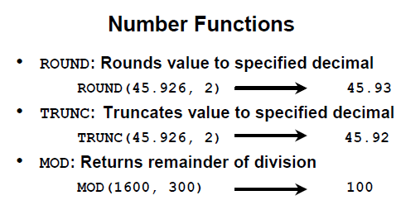
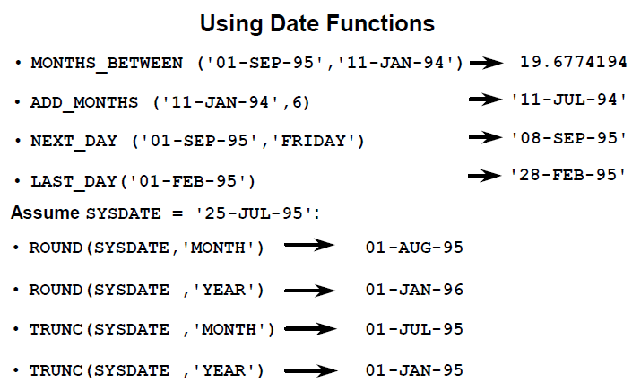

Single row functions

Slide 39
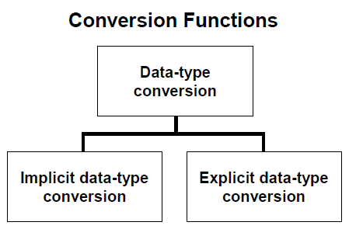
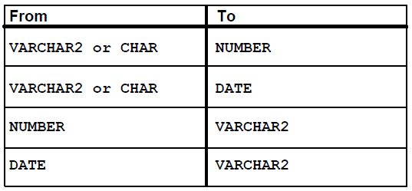
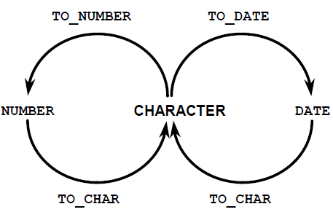
Single row functions

Slide 40
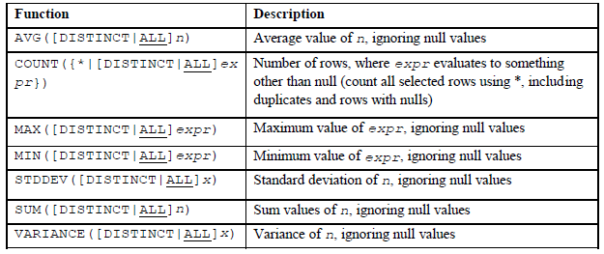
Single group functions

Slide 41
Generating DB structure using Liquibase
9

Slide 42
What is Liquibase?
Liquibase is a migration management tool for relational databases. It versionalizes schema and data changes in a database; similar to the way Git or SVN works for source code.

Slide 43
Why Liquibase?
Uses a distributed locking system to only allow one process to update the database at a time (databasechangeloglock);
Keeps a list of all the statements that have been run against the database (databasechangelog);
Work with branches;
Supports all database types: MySQL, PostgreSQL, Oracle, DB2, etc;

Slide 44
How to use Liquibase?
Maven plugin added in pom.xml;
Directory structure: resources/db/changelog;
File db.changelog-master.xml;
Files which will be included in db.changelog-master.xml, example: db.changelog-1.0.xml;

Slide 45
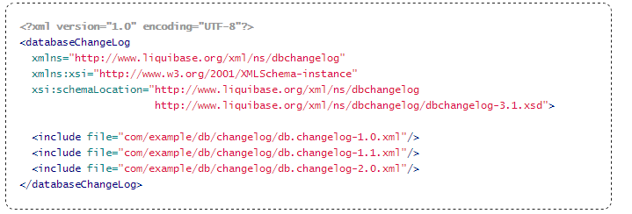
db.changelog-master.xml

Slide 46
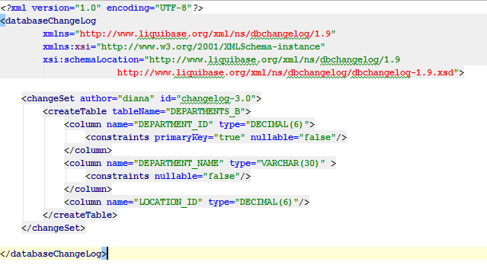
db.changelog-1.0.xml

Slide 47
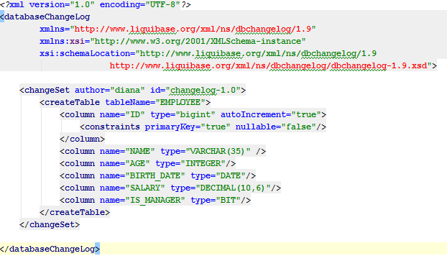
DDL in Liquibase

Slide 48
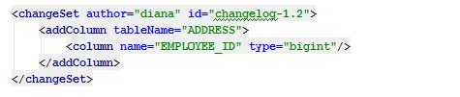
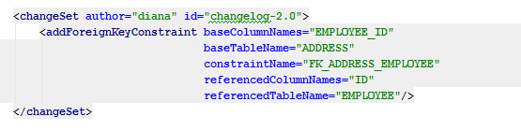
DDL in Liquibase

Slide 49

DDL in Liquibase

Slide 50
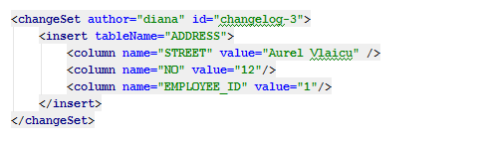
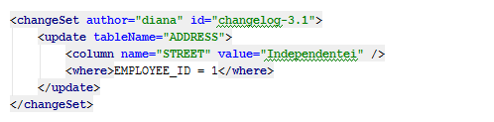
DML in Liquibase

Slide 51
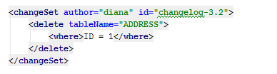
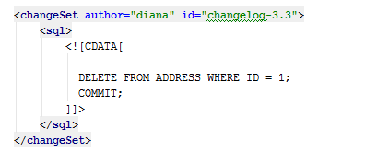
DML in Liquibase

Slide 52
Thank you!

